Slide 1
INK Template Deck | 04.19

Slide 2
Typography styles
HUGE TITLE (Franklin Gothic Condensed Demi, 60pt, line height: .8, all-caps)
LARGE TITLE (Franklin Gothic Condensed Demi, 44pt, line height: .8, all-caps)
MEDIUM TITLE (Franklin Gothic Condensed Demi, 32pt, line height: .8, all-caps)
SMALL TITLE (Franklin Gothic Condensed Demi, 24pt, line height: .8, all-caps)
EYEBROW TITLE (Franklin Gothic Demi, 14pt, line height: 1, all-caps, letter spacing: 1pt, Green)
Extra Large Copy (Franklin Gothic Book, 24pt, line height: 1.125)
Large Copy (Franklin Gothic Book, 20pt, line height: 1.125)
Regular Copy (Franklin Gothic Book, 16pt, line height: 1.125)
Small Copy (Franklin Gothic Book, 14pt, line height: 1.125)

Slide 3
INTRODUCING INK
SLIDE OPTIONS

Slide 4
HELLO, [PROSPECT].
IN THIS DECK YOU’LL FIND
Introduction to INK
Program recommendation
Examples of relevant work
INK’s difference and approach
[Customize: I.e., This is why we loved your RPF and why we are excited to work with you.
This paragraph should have some more interesting copy that alludes to our creative approach.
With our experience in xyz industry, we believe INK would be a great fit for this program. We hope you agree!]
[Your name] + the INK team
yourname@ink-co.com
[your phone number]

Slide 5
We’re ink.
OUR VALUES
ENERGETIC Authentic love for the job. Go the extra mile for our clients, colleagues, and craft.
ENLIGHTENED Apply knowledge as strategic counsel. Be there before.
EFFICIENT Maximize value for our clients. There’s always a better way.
EFFECTIVE Results that matter. Period.
EVOLVED Always learning and applying new knowledge.
We help companies outthink the competition and connect with the people who matter most. We’ve been in the business of building and amplifying brands for over 16 years. During that time, we’ve evolved from a media-focused public relations team to a full-service marketing communications company combining strategy, PR, content, digital, creative, analytics, and research into targeted, data-driven programs that drive growth. We have a team of 40 specialists in our Austin, Denver, and New York City offices.

Slide 6
We’re ink.
OUR VALUES
ENERGETIC Authentic love for the job. Go the extra mile for our clients, colleagues, and craft.
ENLIGHTENED Apply knowledge as strategic counsel. Be there before.
EFFICIENT Maximize value for our clients. There’s always a better way.
EFFECTIVE Results that matter. Period.
EVOLVED Always learning and applying new knowledge.
16+ years in business
Full-service marketing communications firm: strategy, PR, content, digital, creative, analytics, and research
Focused on serving companies in growing and data-driven tech spaces
40-member staff across Austin, Denver, and New York

Slide 7
A leader in tech PR A great place to work
PR News
Stevie Awards
Holmes Report
Austin Business Journal
2020 Agency Elite Top 100
2019 Measurement Expert of the Year Finalist
2019 Top Women in PR
2017 Top Women in PR
2016 Firm of the Year Finalist
2016 Best B2B Program
2016 Best Measurement
2017 Communications Professional of the Year
2018 Boutique PR Agency of the Year Finalist
2019 Top Austin-Area Women Owned Business
2011-19 Best Places to Work
Inc.
PR Daily
2017-19 Best Places to Work
2017-18 Inc. 5000
2017 Best Technology Campaign Finalist
Denver Business Journal
Austin Inno
PROVOKE
2019 Best Places to Work
2018 Best Places to Work
2017 50 on Fire
2020 Global Top 250

Slide 8

INK Moves Brands Beyond Business As Usual.

Slide 9
Our industry Expertise
B2B
Technology
FinTech &
FinServ
Cyber- Security
Our tech client experience runs deep. It’s where we started and remains a primary focus. Semiconductors, wireless, you name it - we’ve covered it.
Fintech moves fast. Our experience lies in telling creative stories that appeal to a risk-averse audience.
From personal identity protection to security frameworks and biometrics, INK has taken a front seat to this exciting industry.
Real Estate
Technology
Consumer brand
& Technology
Retail &
E-Commerce
Data-driven, expert content wins in real estate tech. INK helps RE tech companies combine creative perspective with credibility.
From apps to ales, we’ve expanded to represent national brands across verticals with the common denominator of innovation.
Commerce makes the world go round, and INK has witnessed the industry evolve from bricks and sticks to clicks and beyond.

Slide 10








Our services
INK has a wide breadth of PR, marketing, and creative services that we pull from to create compelling campaigns.
Public
relations
Reach, relate, repeat. Media, analysts, influencers.
Thought
leadership
Build brand trust with generous expertise.
Content
marketing
Fill your funnel and satisfy your sales team.
digital +
social
Amplify your values, message, and mission with control.
CREATIVE +
DESIGN
Bring your brand to life with thoughtful creative design.
Research + Strategy
De-risk the pursuit of uncharted territory with strategic planning.
Brand
STRATEGY
Define the face, voice, and purpose behind your company.
Employee
commS
Inform and rally the people who stand behind your brand.

Slide 11
What we can do for you
We are constantly evolving our offerings, and the skillsets and expertise that drive them, to stay ahead of the communications curve.
Strategy
PUBLIC RELATIONS
DIGITAL SERVICES
CONTENT + CREATIVE
Positioning
Message Creation
Strategic Planning
Social + Digital Strategy
Content + Creative Strategy
Data Analytics
Research + Insights
Persona Id + Development
Focus Groups + Surveys
Planning, KPIs, + Insights
Media Relations
Analyst Relations
Stakeholder Relations
Thought Leadership
Events
Speaking + Awards
Crisis Communications
Media + Executive Training
Social Media Strategy
Community Management
Organic + Paid Strategy
Paid Media
Live Engagement
Influencer Programs
Email Marketing
Lead Generation
Analytics + Insights
Graphic Design
Copywriting
Art Direction
Brand Identity
Podcast Production
Animation
Video + Photography
Marketing Materials
Landing Pages + Websites

Slide 12












A few of our client partners
We’re focused on businesses with tech and data at their core.

Slide 13
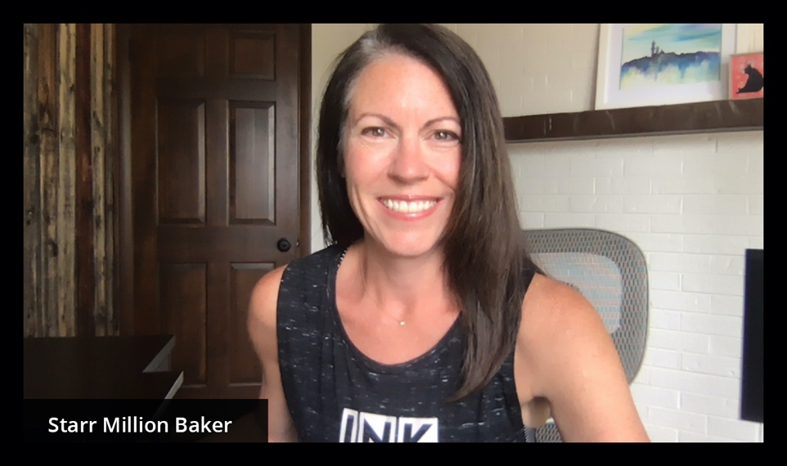
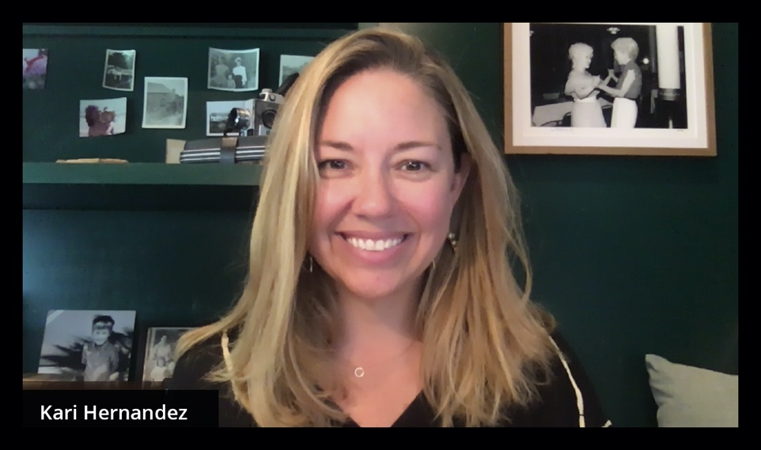
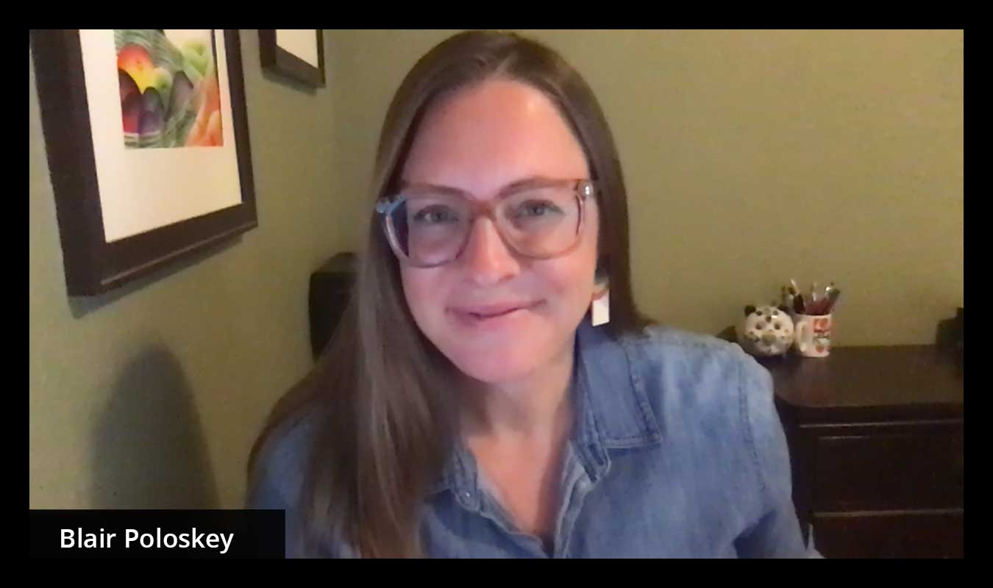
Meet OUR leadership
STARR MILLION BAKER
CEO + Co-Founder
25+ years in tech comms.
Smart, direct counsel for comms and marketing leaders and the C-suite.
PR News Top Woman in PR.
KARI HERNANDEZ
CSO + Co-Founder 20 years in tech comms.
Customer- and data-driven strategy for client and team alignment.
PR News Top Woman in PR.
BLAIR POLOSKEY
SVP + Partner 15+ years in tech comms.
Problem-solver and client champion driving results and exceeding expectations.
Speaker at CES, SXSW on social media.

Slide 14
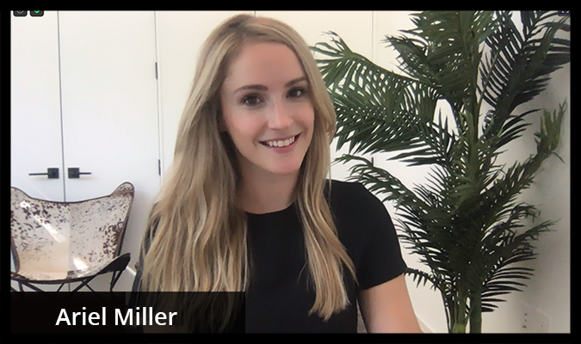
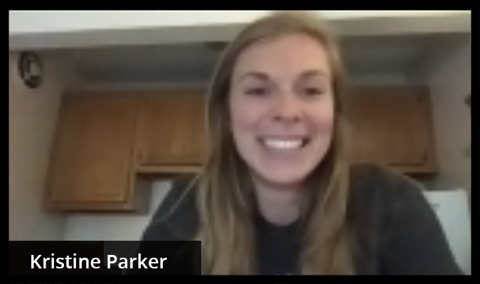
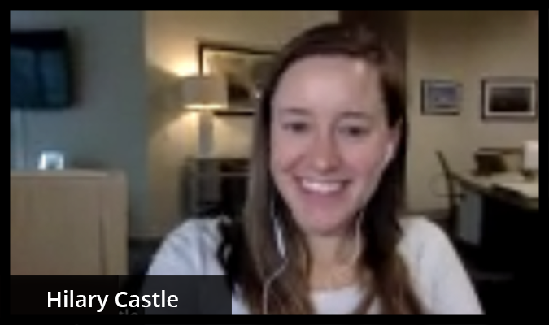
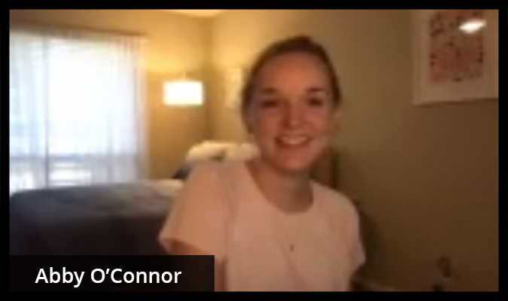
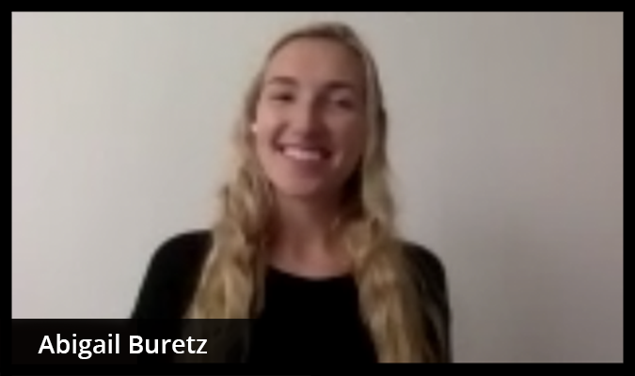
Meet your INK TEAM
Ariel Miller
Account Supervisor
[Add a bio for each team member – be sure to state what role they will play on the account team should we win]
Kristine Parker
Sr. Account Executive
[TBD]
Hilary Castle
Sr. Account Manager
[TBD]
Abby O’Connor
Sr. Writer + Strategist
[TBD]
Abigail Buretz
Asst. Account Executive
[TBD]

Slide 15
Meet your INK TEAM
Ariel Miller
Account Supervisor
[role person will play on the team should we win]
Kristine Parker
Sr. Account Executive
[role person will play on the team should we win]
Hilary Castle
Sr. Account Manager
[role person will play on the team should we win]
Abby O’Connor
Sr. Writer + Strategist
[role person will play on the team should we win]
Abigail Buretz
Asst. Account Executive
[role person will play on the team should we win]

Slide 16

OUR MISSION IS SIMPLE, BUT IT GUIDES EVERYTHING WE DO.
Good work with good people makes for a good life.

Slide 17
Speaking of good people, let’s talk about you.

Slide 18
RESEARCH INSIGHTS
SLIDE OPTIONS

Slide 19
[key finding goes here]
Landscape
[Fill in body copy]

Slide 20
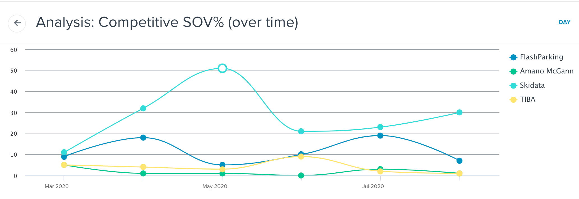
Competitive landscape shown through media coverage
Example for pulling in graphics from Cision dashboards
Competitor coverage is following a trend in this space – lower value media pick-ups around product and solution announcements, with a noticeable lack of true POV-led thought leadership or data-driven stories.
Case in point: SKIDATA.
SKIDATA experienced a boost in May with its Common Access Solution announcement which was picked up primarily by parking trade publications. While SKIDATA does currently hold the majority share of voice (SOV) in the market, FlashParking’s SOV increased (despite the pandemic) from May to June, and June to mid-August, rising to 31% against SKIDATA’s 53%.
This is opportunity here. We’ll tell data-rich stories that will drive thought leadership and up-level coverage beyond the trades to tech and top-tier publications.

Slide 21
[brand thesis]
MARKET DIFFERENTATION / situation analysis
[Fill in body copy]

Slide 22

Where we go from here
Example for bringing a bold path exercise into the presentation/pitch
Smarter cities with less congestion
Intelligence powers market needs
Mobility Hub Operating System
Interest booms in everything-as-a-service
The Bold Path: Opportunities
Demand for integration
Software rules
the Current Path
FP associated with “just parking”
FP’s data stories go untold
Parking solutions haven’t adapted to our reality
COVID drives concerns around CapEx
Market lacks mobility intelligence

Slide 23
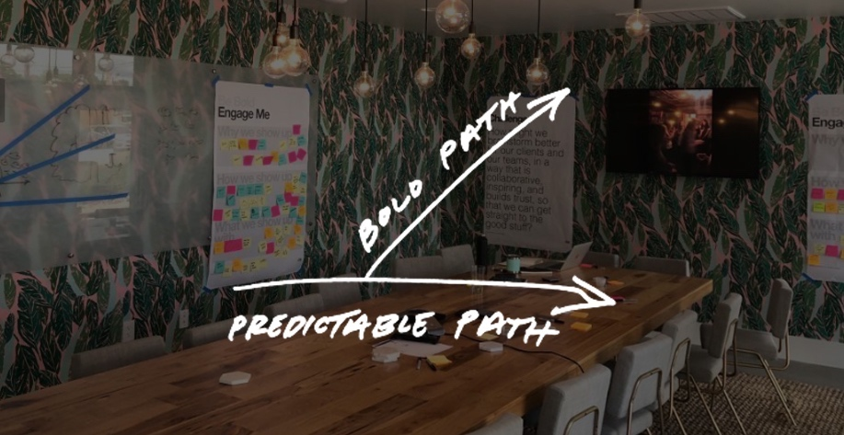

Slide 24
PROGRAM OVERVIEW
SLIDE OPTIONS

Slide 25
[high level strategy]
Recommendation
[Fill in body copy]

Slide 26

Program objectives
Choose an image that represents the prospect
[X]
[Y]
[Z]
[These program objectives are based on our initial knowledge of your business and marketing goals. We will work with your team to finesse, refine, and set clear program KPIs.]

Slide 27

Program objectives
NORTH STAR
Establish FlashParking as the undeniable leader in the parking and mobility world, at a national level
MAPPING TO OUR NORTH STAR
Position FlashParking's touchless technology as the preferred touchless parking/mobility solutions in a low-touch economy
Position FlashParking as the technology layer powering today's smart cities; help define what that story looks like in key cities
Support innovative product launches that shift the company from a B2B to B2B2C

Slide 28
program overview
Customize for your unique opp
AUDIENCE UNDERSTANDING + MEDIA POSITIONING
MEDIA AND ANALYST RELATIONS
THOUGHT LEADERSHIP CONTENT
EVENTS AND PARTNERSHIPS
We’re pumped you’ve completed audience persona work and have foundational marketing elements. Get us up to speed and then we’ll finesse key corporate messages into campaigns that inform, educate and persuade key stakeholders. What we need from you: meeting of the minds on all you’ve learned thus far, feedback to our media positioning ideas, and any insights gleaned from customer engagements as we go.
We get coverage for our clients by pitching handcrafted storylines personally and often. We do not mass pitch press releases (we use press releases to get everyone on the same page, and for lower tier trade media aggregation). We create pitch banks of ideas – including current articles and events on which we can response pitch – and we don’t let a day go by without a pitch going out. What we need from you: customer success stories and newsworthy milestones we can turn into pitches. Compelling spokespeople who have opinions and are willing to share them, quickly
Media rooms are being decimated by layoffs, and LineVision has a topic (separate of the product) on which to educate its audience – these two things can equal a lot of opportunity for contributed content placement across all sectors of media for LineVision leaders. We recommend increasing quantity and consistency of blog posting – those topics can also be used (tweaked) for contributed content. What we need from you: we’ll secure the opportunities and outline the needs of the piece; you’ll need to do the writing internally above 1 piece a month.
Participating in events, sponsoring key research, partnering with industry leaders to push an agenda forward – these are all areas in which INK has experience and can help. We’d manage speaker submissions and share strategy and ideas for making the most of your presence (even virtually) at key events throughout the year. What we need from you: alignment on prioritization of events, availability of spokespeople

Slide 29
program overview
AUDIENCE UNDERSTANDING + MEDIA POSITIONING
MEDIA AND ANALYST RELATIONS
THOUGHT LEADERSHIP CONTENT
EVENTS AND PARTNERSHIPS
Finesse key corporate messages into campaigns that inform, educate and persuade key stakeholders
Handcraft storylines
Develop pitch bank of ideas
Pitch every day
Mine FlashParking’s data
Create market insights that bring value to key audiences
SME interviews and POV identification
Manage speaker submissions
Consult on event presence strategy

Slide 30
PROGRAM SPECIFICS
SLIDE OPTIONS

Slide 31
Pitch angles
For highlighting pitch angles and mapping back to prospect’s objectives, calling out specific reporters
While part of our outreach will focus solely on Khoros Care, we’ll also leverage the brand awareness around the other products in the Khoros suite to our advantage. We’ve mapped our pitch angles to company-wide campaigns to cross-promote Care and convey why a fully-integrated program (Marketing + Care + Communities) is the most effective solution for customer engagement. We’ve also identified angles that can tie Khoros Care to the central topic driving 2020’s news - COVID-19.
 | STREAMLINE SOCIAL MARKETING | DELIVER DIGITAL-FIRST CUSTOMER CARE | BUILD COMMUNITY | A COMPLETE DIGITAL-FIRST CUSTOMER EXPERIENCE
Goal Headlines | Data from social listening and customer care is crucial to marketing in the age of COVID How digital customer care and social listening strategies can inform marketing to today’s largely virtual customer base | How to gain customer trust through digital-first customer care Why automated intelligence (not artificial intelligence) is driving the future of personalized customer care | The importance of self-service customer care amid the COVID-19 pandemic Building a community-centered approach to humanize your customer care strategies | Successfully preparing for the next wave: 4 topline customer engagement priorities for CXOs, CX/Marketing/Care executives Defining and humanizing what "digital experience" looks like in the new normal
Storylines and Targets | As COVID has prompted rapidly shifting customer demands, social listening and intel garnered from customer care interactions can work together to provide richer, real-time insights that enable marketers to quickly pivot and take the right action. The way business is being conducted has shifted – and so must how you glean insights to inform your marketing strategy. Digital Commerce 360, April Berthene ClickZ, Mahir Prasad Digiday, Kristina Monllos Marketing Land, Ginny Marvin | Digital-first customer care drives brand innovation through transparency among customers. AI may be the hot buzzword, but automated intelligence is really what’s driving the tech behind personalized customer care solutions. CMO, Rosalyn Page Venture Beat, Kyle Wiggers Business Insider, Lucia Moses Fortune, Jonathan Vanian | Discuss exactly what self-service means and the importance of pairing this community resource with Care to improve the customer experience. Will highlight how this has grown in importance amid the pandemic and can focus in on verticals that have had the largest upticks in customer care demand stemming from COVID. Promote the HP case study that showcases how the company used Khoros Care paired with Khoros Communities to centralize its support knowledge base, add a humanizing element to customer care, and better serve its customers. ZDnet, Joe McKendrick eMarketer, Doug Clark Entrepreneur (contributed content) Protocol, David Pierce | Focus on lessons learned in the initial months of the pandemic and priorities to consider as we prepare for the future. Spoiler alert, a complete digital customer experience is required. Discuss how COVID-19 accelerated digital-first customer service solutions and why the future of digital experiences needs to be humanized, personalized and complete. Forbes, Gene Marks DestinationCRM, Leonard Klie MarTech Advisor, Ameya Dusane Solutions Review, Timothy King
Notes:
This slide framework can also work for thought leadership angles – see following slide.

Slide 32
owned + earned Media STORYLINES
For highlighting all of your pitch angles, mapping back to personas, objectives, themes, and calling out specific pubs
We’ll leverage FlashParking’s suite of capabilities to tell data-driven, future-forward stories across key platforms. By mapping back to objectives, each storyline will tell a cohesive story, targeting audiences where they already are. Below is a sampling of the possible stories we’d love to tell to establish FlashParking as the undeniable leader in the parking and mobility world, at a national level.
Theme | Mobility Innovation Powered by business intelligence & technology | Smart City Intelligence Powering today’s cities | Ecosystem Of Choice Powering key industries
Program Objective | Position FP’s touchless technology as the preferred touchless parking/mobility solutions in a low-touch economy. | Position FP as the technology layer powering today's smart cities: Detroit, Austin, Miami and Philadelphia (to start). | Position FP as the preferred parking/mobility solution partner in key verticals.
Storylines and Targets | The industry is rapidly changing, prompting a need for customizable and scalable operations. That’s why FlashParking is paving the way for a new technology category: the mobility hub operating system. Leveraging business intelligence and real-time insights, FlashParking’s technology is bringing the future to mobility. Protocol TechCrunch The Wall Street Journal WIRED | Buzz around smart cities is nothing new, but what does this innovation look like in action? Treating every city like a unique fingerprint, FlashParking solves the mobility challenges that come with outdated infrastructure and archaic technology. FlashParking is the technology layer every major city needs to modernize. Bloomberg CityLab Crain’s Detroit Miami Herald Smart Cities Dive | While this program objective wasn’t explicitly stated, the need for innovative parking solutions extends into many industries. As various verticals seek to streamline the customer experience and diversify their revenue, FP is the undeniable partner of choice for custom-configurated solutions to catapult businesses into the future.. Automation World Parking and Mobility Magazine Smart Cities Dive Smart Cities World
Persona | Owner VP or Head of Parking CIO Consumer | Local officials Local owners Day-to-Day operators Facility managers | CIO IT Municipal Operator Parking Consultant
Goal Headlines | This company was creating a mobility category before we knew we needed one Innovation in mobility was outpacing what city infrastructures can handle – until now Why parking is prime for a touchless model | How FlashParking reduced Trader Joe’s parking congestion by 68% FlashParking revolutionized a congested Philadelphia – how did they do it? Connected parking is creating a new lifestyle for city dwellers | Mobility is the latest disruption to the hospitality industry – here’s how The company taking the pain points out of airport parking Meet parking intelligence – the technology set to cut your expenses by 80%

Slide 33
Media STORYLINE: Mobility Innovation
Theme: Powered by business intelligence & technology
Objective: Position FP’s touchless technology as the preferred touchless parking/mobility solutions in a low-touch economy.
FlashParking’s technology is bringing the future to mobility.
KEY TARGETS
Protocol
TechCrunch
The Wall Street Journal
WIRED
TARGET PERSONAS
Owner
VP or Head of Parking
CIO
Consumer
Option for highlighting individual pitch angle, typically transition to this from table slide for pitch deck
GOAL HEADLINES
This Company was Creating a Mobility Category Before We Knew We Needed One
Innovation in Mobility Was Outpacing What City Infrastructures Can Handle – Until Now
Why Parking is Prime for a Touchless Model

Slide 34
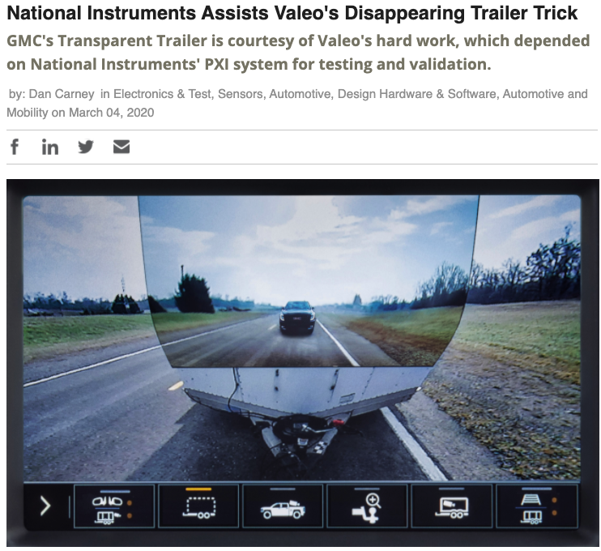

Automated vehicles tech innovation story
Option for highlighting individual pitch angles and our experience
The angle
OUR EXPERIENCE
Many have long- touted the benefits of autonomous vehicles’ low-touch model for consumers, and the pandemic amplified that. But as buzz around adoption grows, we overlook that a major barrier to rollout is continually testing, refining, and repairing the tech. That task is made exponentially more difficult as we live in a time where engineers often must work remotely to ensure their own safety.
Katie can speak to why the AV conversation should look less at consumer benefit and more at how a low-touch maintenance model can speed up adoption, as well as how AR tech enables that.
TARGETS: Axios, Joann Muller TechCrunch, Kristen Korosec Mashable, Sasha LeKach
Angle: How testing technology cut development time for innovative trailer
Pitch type: Proactive customer story
Outlet: Design News (76K unique monthly views)
Notes:
[Fill in appropriate case study image]

Slide 35
Who you need to know
Customize for your opp
This is an example – not exhaustive – list of media and influencers that need to have LineVision on their radar. INK has worked with a cross-section of reporters from these outlets over the years, most recently via our work with Enel and its partners and customers.
ENERGY
UTILITY
NATIONAL
INFLUENCERS
AltEnergy Mag
Breaking Energy
E&E News
Energy Central
Energy CIO Insights
Energy Digital
Energy Manager Today
Greentech Media
Recharge
Electric Light & Power
IEEE Spectrum
POWER Magazine
POWERGRID
RTO Insider
T&D World
Utility Dive
Axios
Bloomberg
Business Insider
Financial Times
Forbes
Fortune
New York Times
The Verge
Wall Street Journal
Washington Post
ACEG
Bloomberg New Energy Finance
Energy Finance Daily (S&P Global Market Intelligence)
Grid Strategies
IHS Energy
Penn Energy
Navigant Research
The Energy Journal

Slide 36
Repeatable process + Added value
DATA
TEMPLATE
LISTS
INTERVIEWS
COVERAGE
What’s the story? Headlines?
New targets? What do we know they will ask?
Build & leverage relationships.
Optimize tracking month over month. How did we do? Why?
APPROVE, PITCH, MEASURE, OPTIMIZE, REPEAT

Slide 37

introductory Analyst briefings
Option for simply stating the beginnings of an analyst program.
The analyst community can provide valuable feedback as we begin to chart the course for category creation and transitioning to a B2B2C business model.
Here’s a preview of some targets we’d like to start building relationships with:
IDC, Matt Acaro – Research Manager, IoT and Mobility
Forrester, Julie Ask – Consumer Mobility
ABI Research, Dominique Bonte – Intelligent Transportation

Slide 38
THOUGHT LEADERSHIP
Customize for your opp
Our strategy will position Mike Betzer and our other thought leaders as the go-to experts on customer care. By building a foundation around digital-first experience and automated intelligence, we’ll offer CXOs actionable guidance to succeed with their customers.
 | ELEVATING THE CXOS AND CUSTOMER CARE EXECS | THE POWER OF AUTOMATED INTELLIGENCE | WORKING IN THE “NEXT NORMAL” | DELIVERING DIGITAL-FIRST CUSTOMER CARE
Tactic | Primary: podcast Secondary: contributed content | Primary: speaking engagement Secondary: contributed content | Primary: newsjacking Secondary: contributed content | Primary: contributed content
Storylines and Placements | Speaks to how Khoros Care is unlocking new skills and opportunities for customer care executives, offering smarter approaches to customer management. Answering questions on Quora and Clarity relevant to customer care focus areas. The Modern Customer Podcast Entrepreneur | While others are focused on artificial intelligence, we want to shift the conversation to automated intelligence. The Khoros vision for business automation centers to help teams get more done, delivering faster and better customer experiences at a rapid scale. The Next Web SaaStr Annual | Share lessons learned from the initial months of the pandemic and priorities for CXOs to focus on throughout the year. COVID-19 may have accelerated digital-first customer service solutions, but we were heading into digital experiences anyway. How can companies make sure they’re harnessing these experiences in a smart way? Forbes Amazing Business Radio with Shep Hyken | Partner with customers, develop case studies, and work with influencers to showcase the importance of digital-first customer care. As digital experiences become a more integral part of customer care, share the steps companies can take to ensure they’re delivering to their biggest supporters. G2 ClickZ

Slide 39
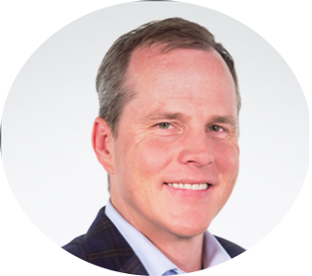
Matt Flake
CEO
Boogie Wittenburg
EVP Customer Experience
Will Furrer
Chief Strategy & Marketing Officer
Adam Blue
Chief Technology Officer
Thought leadership spokesperson roster outline option
OWNS
Corporate strategy and vision
Major news
IMMEDIATELY
Media intros, meet & greets re Q2 transformation
FUTURE
CEO & top tier events: Bloomberg Breakaway CEO, Money2020, Mobile World Congress
Business media and broadcast on banking/lending trends
OWNS
Leader of FinX101 Part 2
Top tier analyst conversations
IMMEDIATELY
Analyst conversations re FinX
Media intros re financial customer experience
FUTURE
Top digital banking and industry events like Digital Banking Summit, ACUC, Finovate
Trade and business publications like PaymentsSource + BI
Analyst meetings/conferences
OWNS
Financial branding and marketing topics
Partnership/acquisition news
IMMEDIATELY
ID financial marketing/ branding panel opps for 2020
FUTURE
Financial Brand Forum, SXSW, TechCrunch Disrupt
Trade and business publications when defining the customer mindset
OWNS
Co-leads FinX101 Part 1
Technical + digitization trends
Tech’s influence on FinX
IMMEDIATELY
Proactive & reactive media as opportunities arise
FUTURE
Association for Financial Tech event; Finovate
Bank tech publications like Fintech Future and Bank Systems & Technology

Slide 40
Rekha Garapati
Product & Hosting
Lou Senko
Chief Information Officer
Paul Walker
General Manager
Thought leadership spokesperson roster outline option
OWNS
Source for FinX101 Parts 1 and 2
Product innovation + updates
FinX innovation + development
IMMEDIATELY
Proactive & reactive media as opportunities arise
FUTURE
Tactical banking and industry events like JAC TechConnect or AFP
Trade media relationships, especially around customer case studies
OWNS
Co-leads FinX101 Part 1
Digital strategy/automation
Q2 tech growth journey
IMMEDIATELY
Proactive & reactive media as opportunities arise
FUTURE
Strategic tech events like NACHA Payments and AFT
CIO publications like Banking CIO Outlook
OWNS
Source for FinX101 Parts 1 and 2
API and open banking trends
IMMEDIATELY
Proactive & reactive media as opportunities arise
FUTURE
Fintech events like Finovate and various TechConnects
Fintech and general tech publications like Fintech Magazine and TechCrunch

